Slide 1

ERP College Management System

Slide 2
Team Members
Employee ID | Name
2498160 | Iragam Reddy Bhramhananda Reddy
2498039 | Pathakota Sahithi
2498862 | Sadiya Banu
2498773 | Guntimadugu Kartheek Varma
2498870 | Matta Narendra Kumar
2498373 | Pochana Lokeswara Reddy
2498702 | Ravulapenta Bharathi
2498901 | Hanumanta X
2499006 | Gummadi Shirisha
2498698 | Mahesh Kumar

Slide 3
Abstract
To get rid of manual burden we present College ERP System which is automated and centralized
This system have easy user interface and have powerful data management system which makes this system very useful.
It handles all the activities going inside an Institution without much effort.

Slide 4
Introduction
College ERP system is a desktop based Software used for an educational institute.
Purpose : To replace current manual system of educational institute with an interactive and automated software Application
College ERP system manages entire Administration, System and Staff management.
High volume of data can be stored
Maintenance of file is efficient and flexible.
Records are always updated.
Edition of stored data and procedures can be easily done
Manpower is reduced.

Slide 5
Problem Definition
The college ERP software solution will include the following primary modules:
Home
About College
Student
Faculty
Librarian
Admin

Slide 6



Software Requirement
Front end : Angular
Backend : MySQL and Spring Boot

Slide 7

Testing Tool

Slide 8
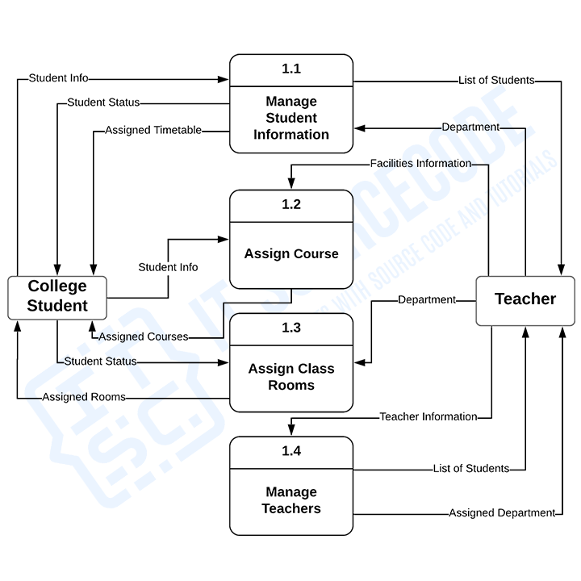
Data Flow Diagram

Slide 9
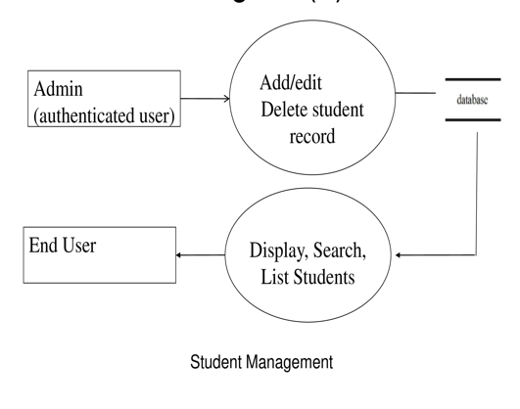
Student Management dataflow diagram

Slide 10
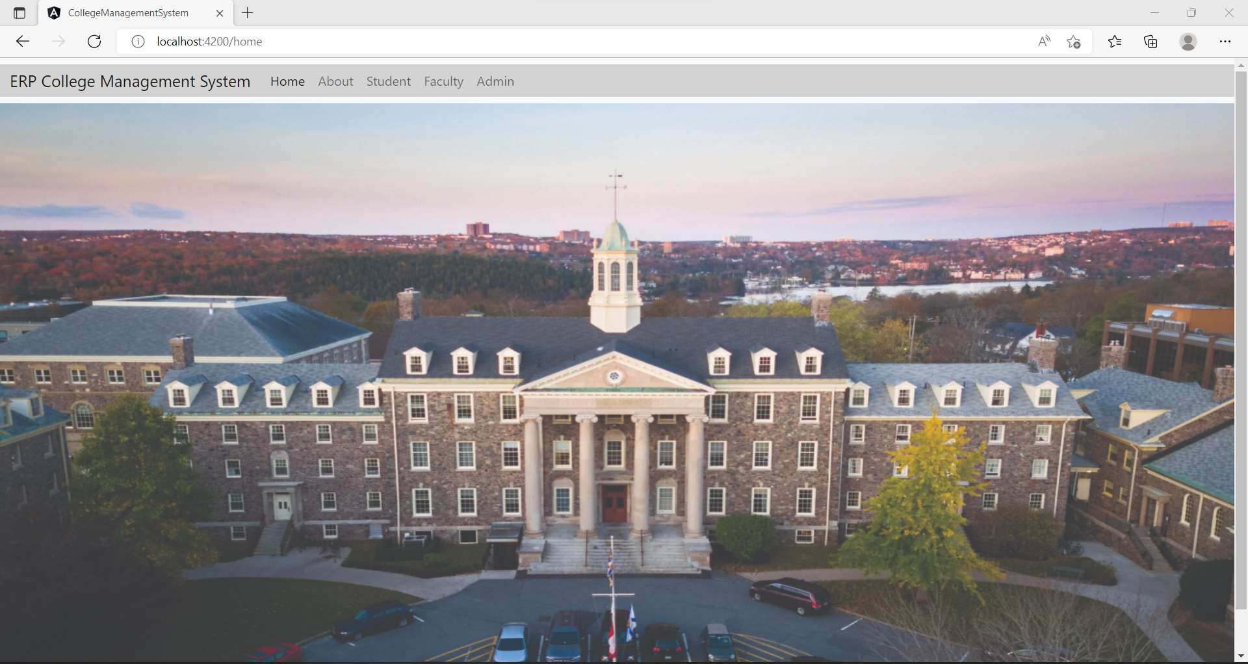

Slide 11
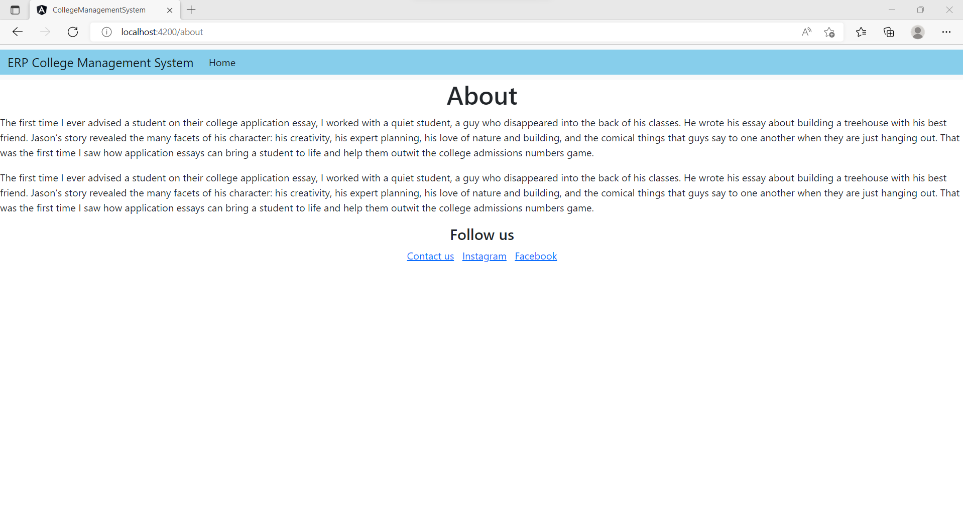

Slide 12
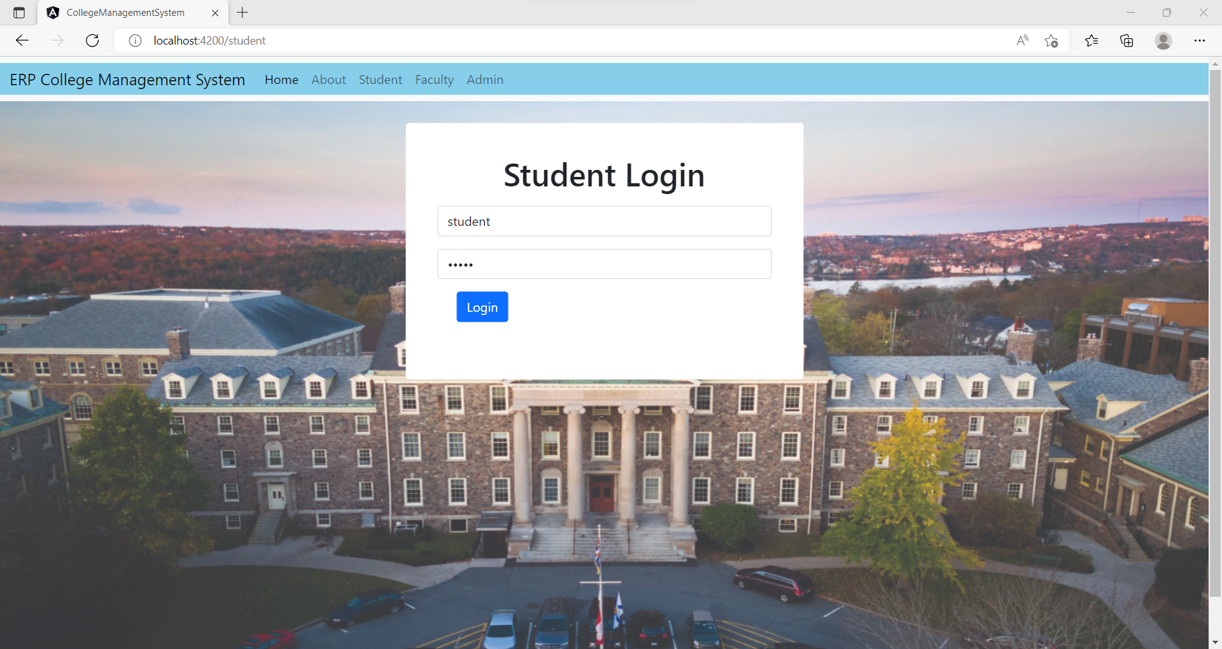

Slide 13
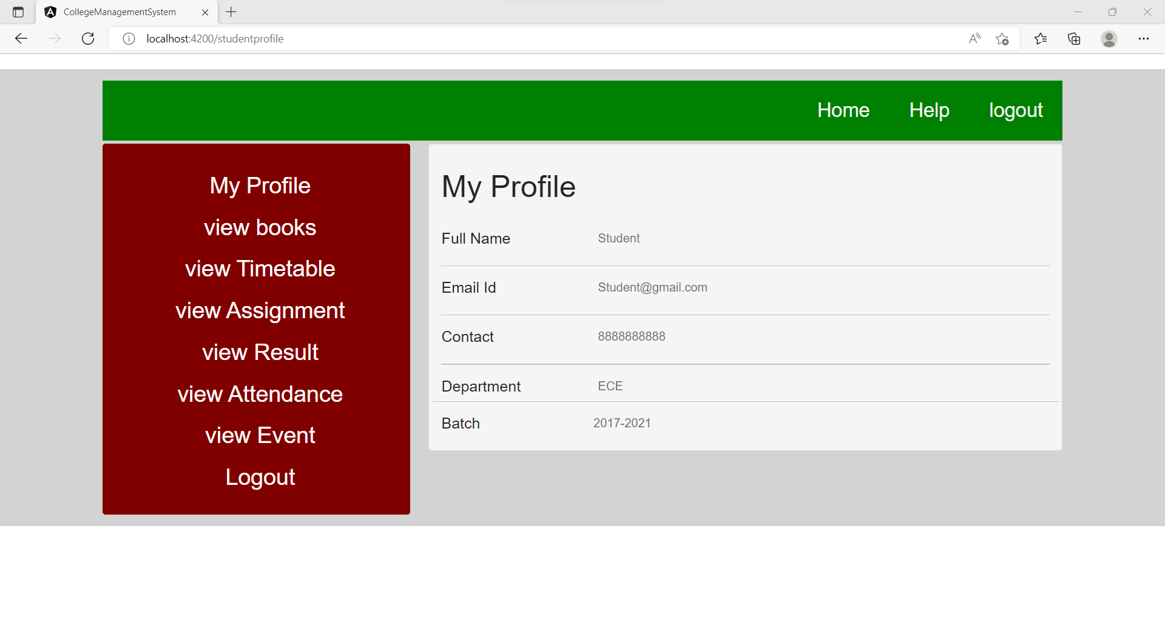

Slide 14
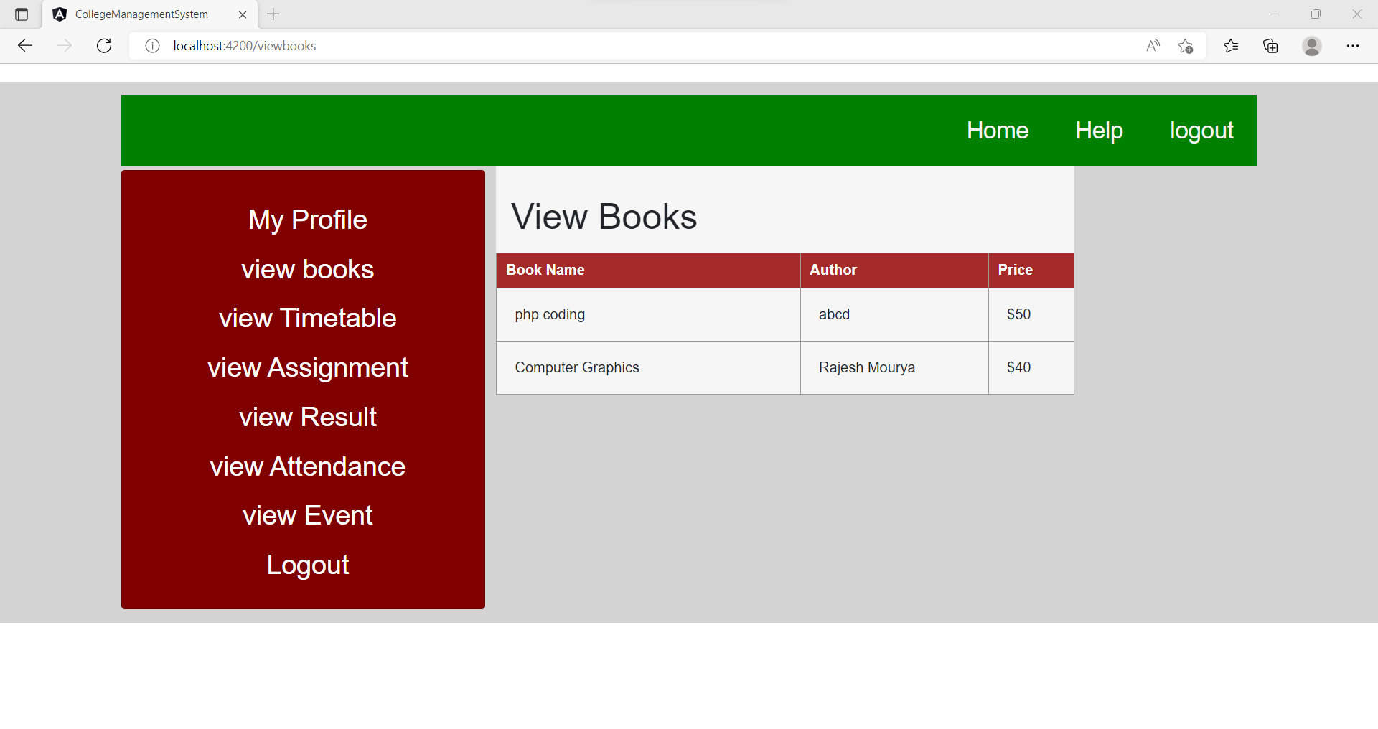

Slide 15
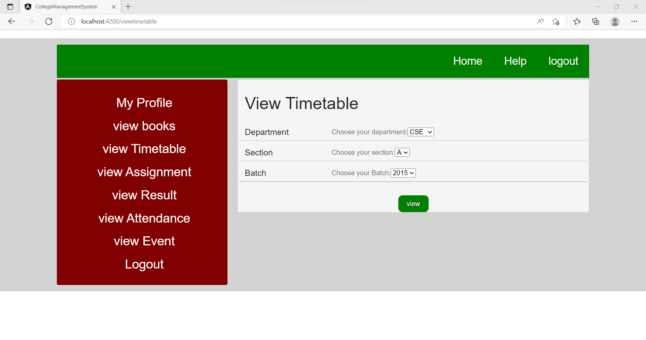

Slide 16
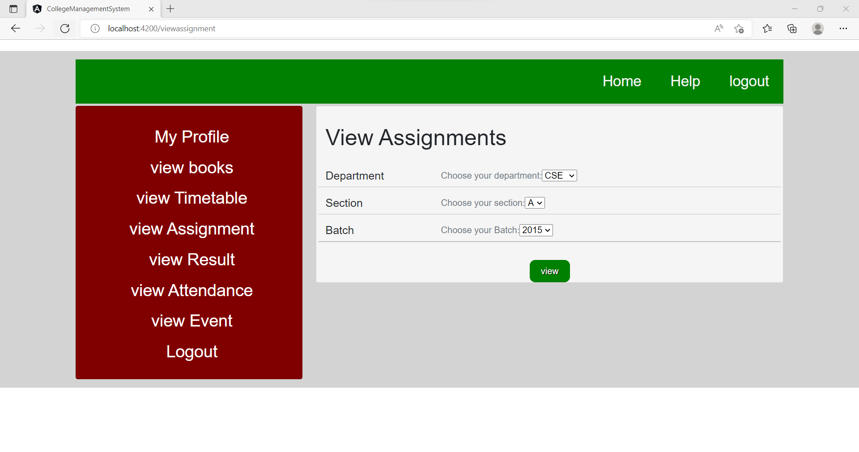

Slide 17
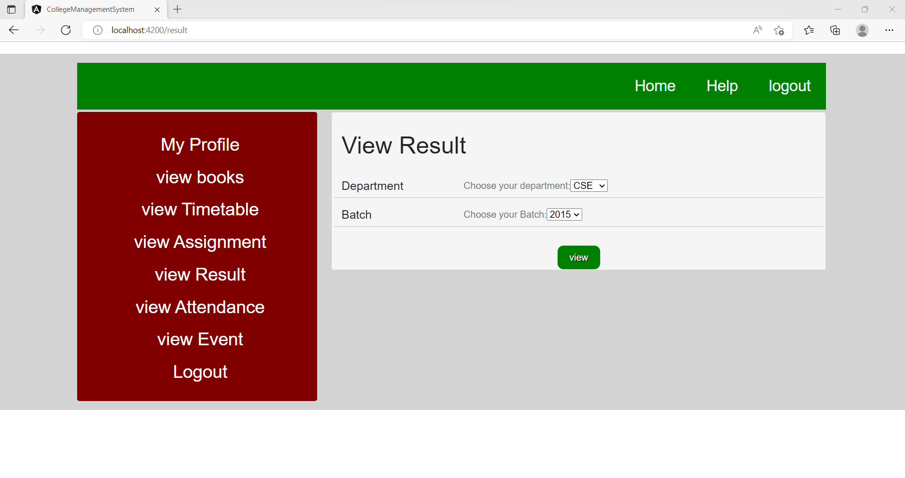

Slide 18
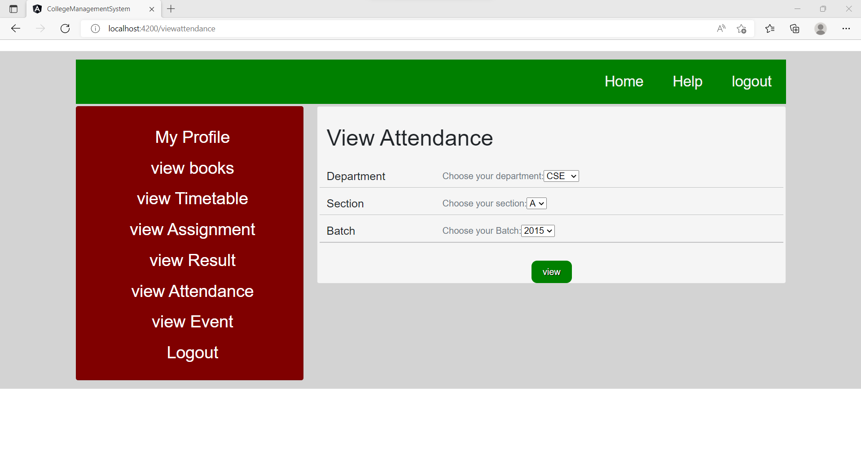

Slide 19
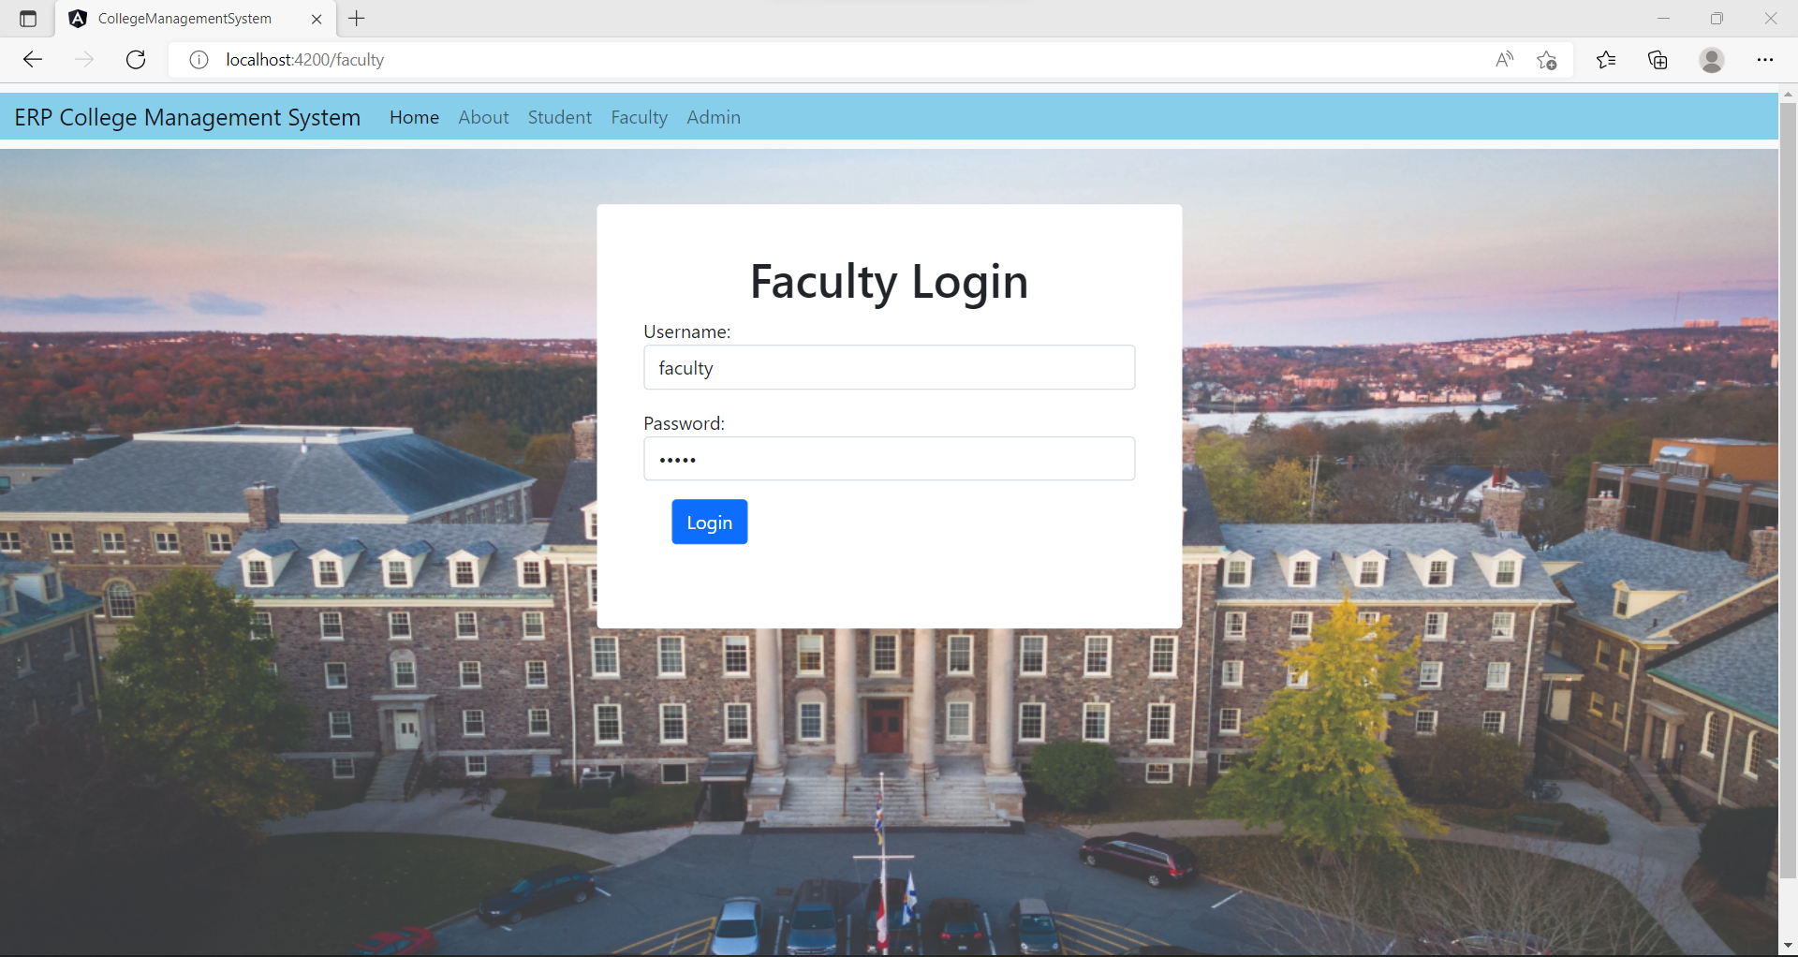

Slide 20
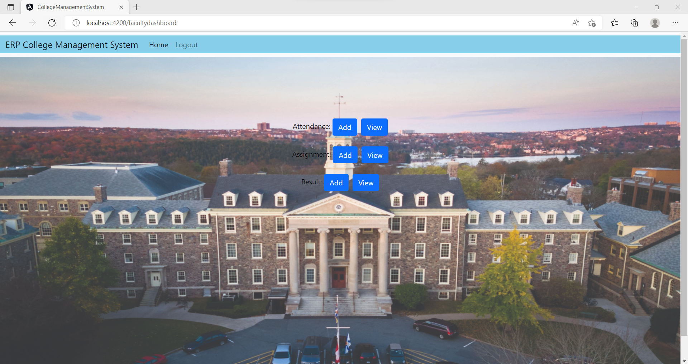

Slide 21
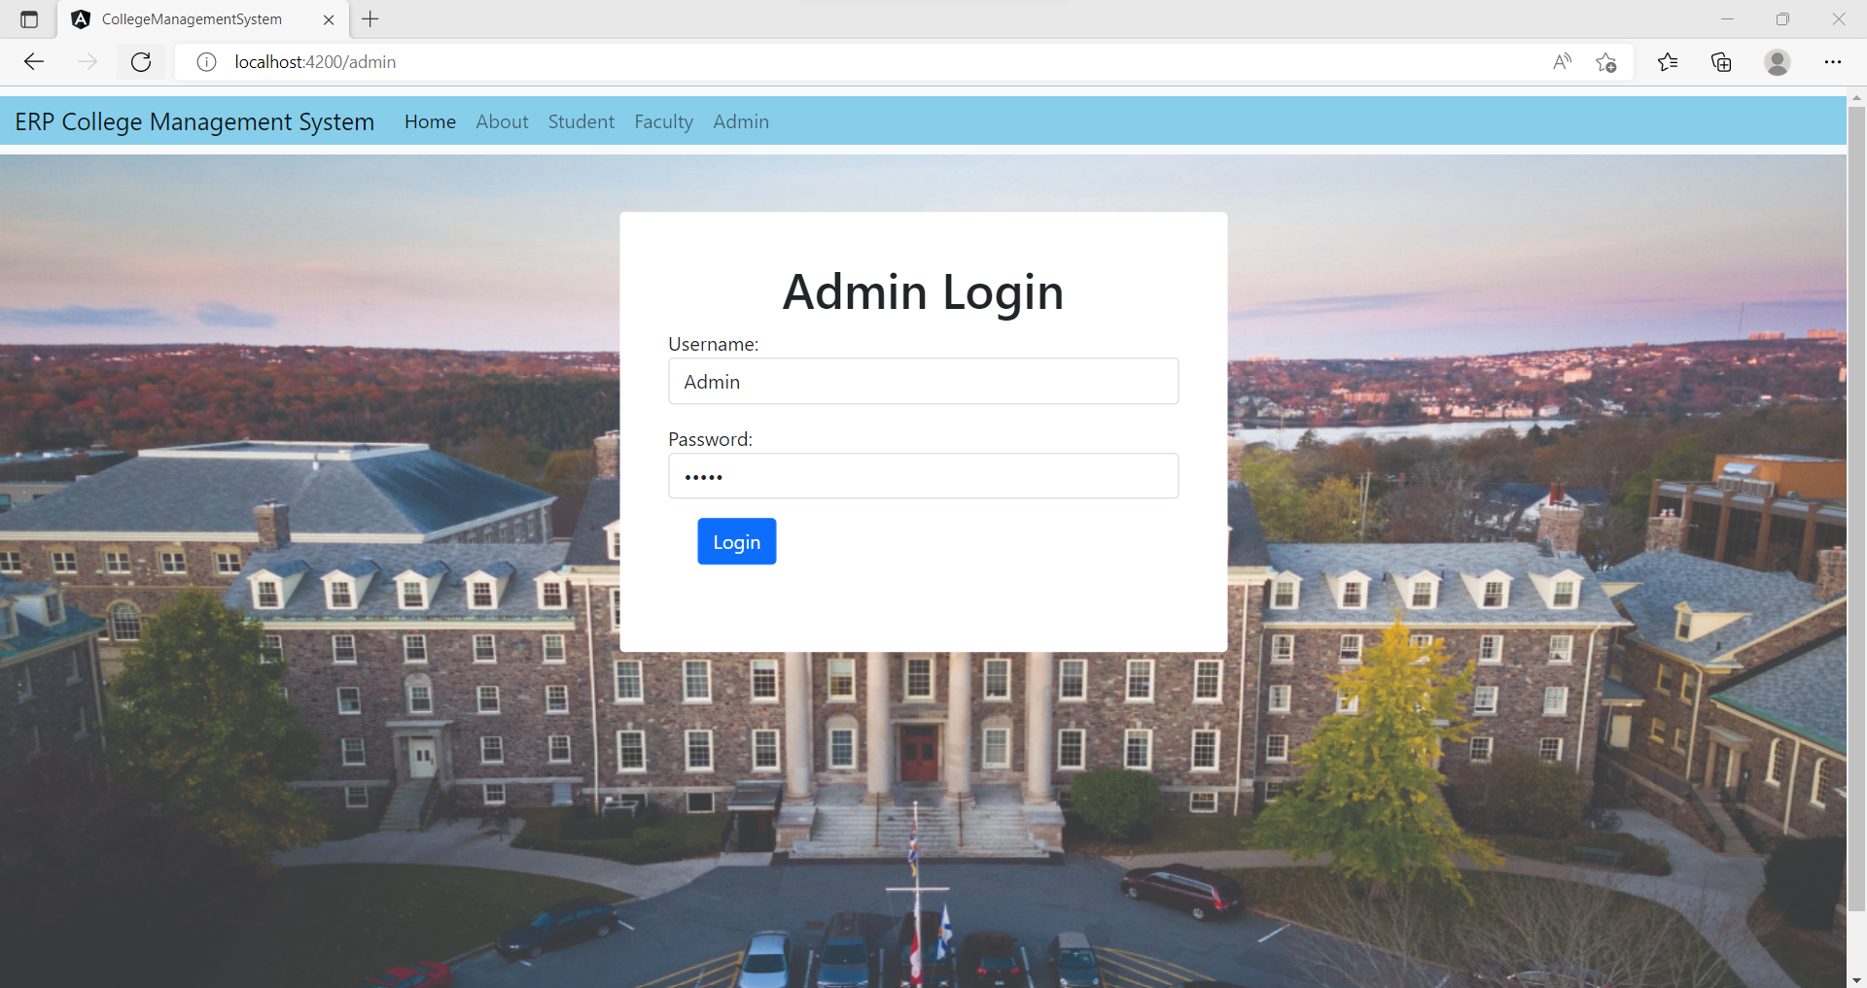

Slide 22
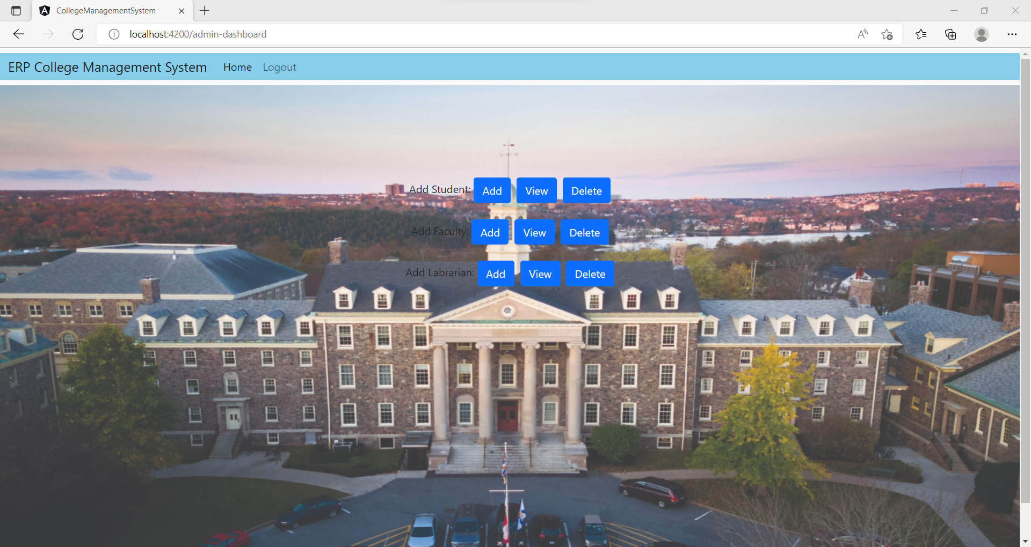

Slide 23
Project Scope
This project deals with the various functioning in college management process. The main idea is to implement a proper process to system.
In our existing system contains a many operations registration, student search, fees, attendance, exam results records, performance of the student
It is helpful for teacher and students

Slide 24
Conclusion
The project entitled as College Management System is the system that deals with the issues related to a particular institution. This project is successfully implemented with all the features mentioned in the system requirements specification. Awareness and right information about any college is essential for both the development of student as well as faculty. So this serves the right purpose in achieving the desired requirements of both the communities.

Slide 25


